Slide 1


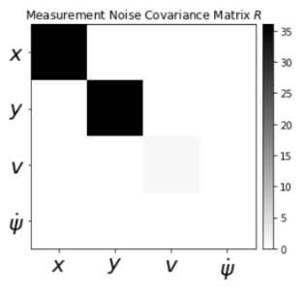
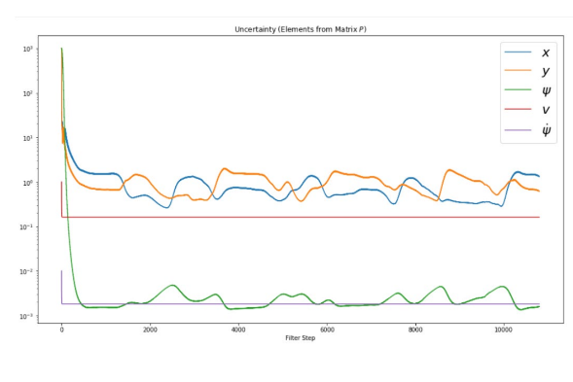
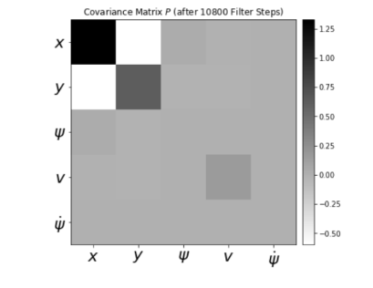
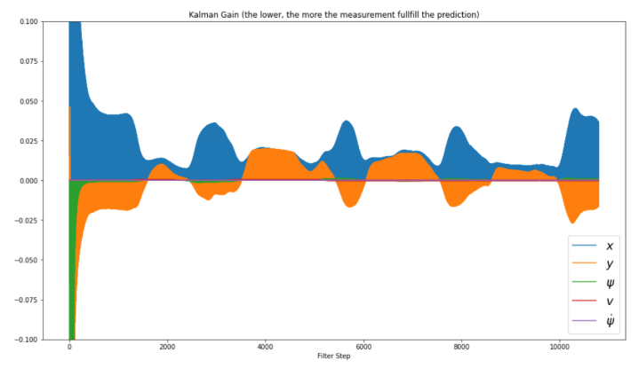
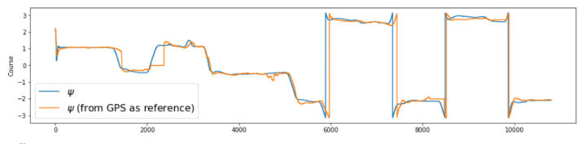
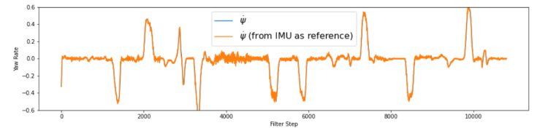
Team AVIDA
Extended Kalman Filter
Sowjanya Matkala
Abstract
Methodology
In this project, we studied about the Kalman filter, its usage, differences with extended Kalman filter and its applications in machine learning. Kalman filter is extensively used in estimating the car position using Lidar and Radar sensors. We learnt that there is certain limitation to Kalman filter as it cannot be used for non-linear function and so, Extended Kalman
Filter is introduced to overcome this challenge by linearizing the nonlinear function of current estimate and then using the same Kalman filter
algorithm to process further.
1. Predict the state ahead
2. Predict the error covariance ahead
3. Compute the Kalman Gain
4. Update the estimate with the
measurement
5. Update the Error Covariance
Predict
Update
1. Predict the state ahead
2. Predict the error covariance ahead
Compute the Kalman Gain
2. Update the estimate with the measurement
Update the Error Covariance
Introduction
A self-driving car needs a map of the world around it as it drives. It must be able to track vehicles, pedestrians and other moving objects on the road
continuously and to track these movements we take continuous and dynamic measurements from various sensors like Radars, Lidars etc. But there is usually a challenge that sensor measurements are uncertain due to reason which includes, but not are limited to, errors from a sensor, discrepant measurement from multiple sensors. So to get the accurate measurements by reducing the error we use an algorithm knows as Kalman Filters. A Kalman filter is an optimal estimation algorithm used
to estimate states of a system from indirect and uncertain measurements.
A Kalman filter is only defined for linear systems. If you have a nonlinear system and want to estimate system states, you need to use a nonlinear
state estimator.
Kalman filter is extensively used in estimating the car position using Lidar and Radar sensors. Measurement of these sensors are not accurate as they are subject to drift or noisy. Kalman filter can be used to fuse the measurement of these sensors to find the optimal estimation of the exact position.
Sensors which is used in this project are Radar and Lidar. The RADAR, is less accurate but is able to provide an estimate of both position and velocity of an object. The velocity is estimated using the Doppler Effect. Radar is able to detect objects up to 200 m from the vehicle. It is also less impervious to weather conditions. Whereas, LIDAR uses a laser for
measurement and generates a point cloud of the world around it providing the car with fairly accurate position x and position y values. It is
able to detect objects in the vicinity of the car (20–40 m) with very high accuracy. However, LIDAR is not very accurate in poor weather conditions or if the sensor gets dirty.
Results
Conclusions
The Kalman filter is relatively quick and easy to implement and provides an optimal estimate of the condition for normally distributed noisy sensor
values under certain conditions. But there is certain limitation to Kalman filter as it cannot be used for non-linear function and so, Extended Kalman
Filter is introduced to overcome this challenge by linearizing the nonlinear function of current estimate and then using the same Kalman filter
algorithm to process further.
Figure 1. Uncertainty of element p
Figure 3. Covariance matrix
Figure 4.Kalman Gain.
Contact
References
Team AVIDA
Team Id –SDCC2021001
National Institute of Technology, Agartala.
LinkedIn: Team Avida/LinkedIn
Phone:7905155527
https://medium.com/@akhilsuri194/building-an-autonomous-vehicle-part-4-1-sensor-fusion-and-object-tracking-using-kalman-filters-66589e522965
https://medium.com/@akhilsuri194/building-an-autonomous-vehicle-part-4-2-8049cda5a92
https://medium.com/@akhilsuri194/building-an-autonomous-vehicle-part-4-3-2a506e57d830
https://www.kalmanfilter.net/default.aspx
https://thekalmanfilter.com/kalman-filter-explained-simply/
https://www.bzarg.com/p/how-a-kalman-filter-works-in-pictures/
https://towardsdatascience.com/kalman-filter-an-algorithm-for-making-sense-from-the-insights-of-
various-sensors-fused-together-ddf67597f35e
https://blog.quantinsti.com/kalman-filter/

